Slide 1
Introduction to Apache Hadoop
Ami Gandhi
Master Of Science in Information Systems
Northeastern University
gandhi.am@husky.neu.edu

Slide 2
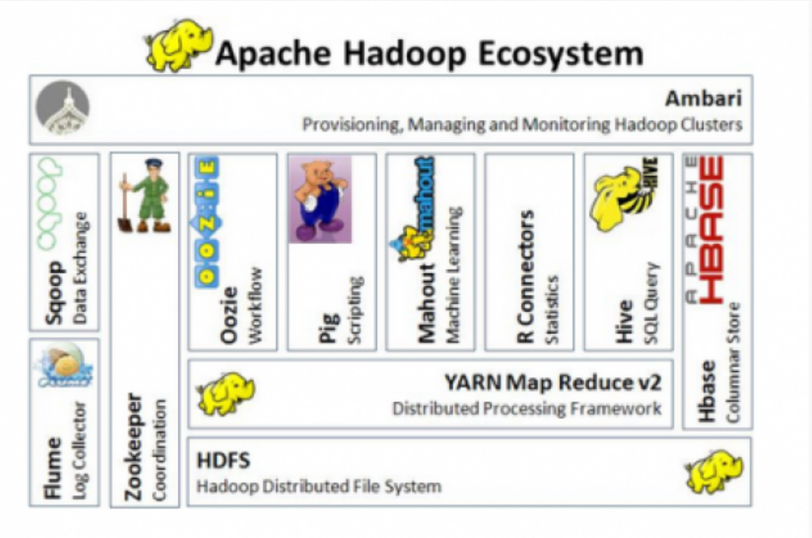
Apache Hadoop Ecosystem
Hadoop is a framework written in Java for running applications on large clusters of commodity hardware
The Apache Hadoop framework is composed of the following modules -
Hadoop Common: contains libraries and utilities needed by other Hadoop modules
Hadoop Distributed File System (HDFS): a distributed file-system that stores data on the commodity machines, providing very high aggregate bandwidth across the cluster
Hadoop YARN: a resource-management platform responsible for managing compute resources in clusters and using them for scheduling of users' applications
Hadoop MapReduce: a programming model for large scale data processing

Slide 3
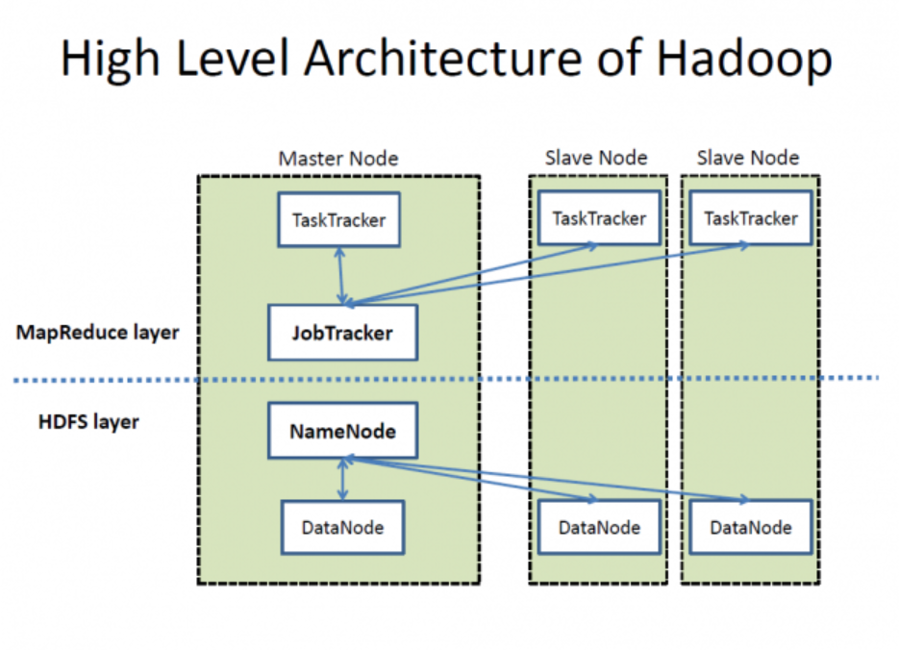
Hadoop High Level Architecture

Slide 4
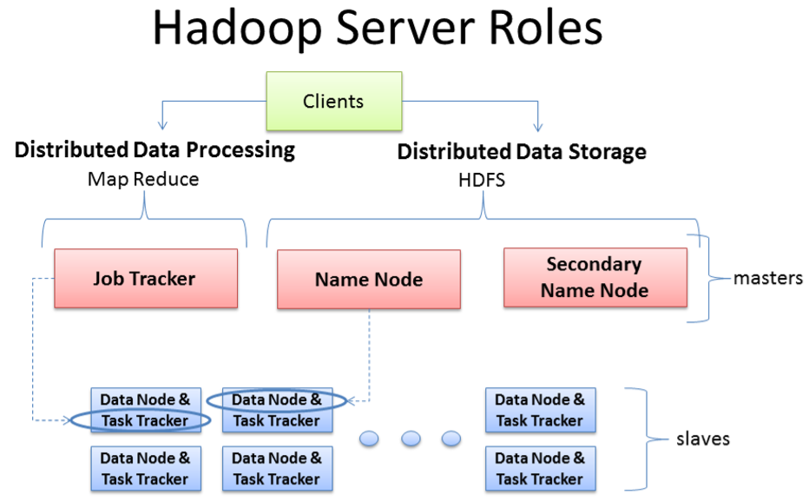
Hadoop Server Roles
Three major categories of machine roles in Hadoop
Client machines
Master nodes
Slave nodes

Slide 5
Client Machines
Client machines have Hadoop installed with all the cluster settings, but are neither a Master or a Slave
Instead, the role of the Client machine is to load data into the cluster, submit MapReduce jobs describing how that data should be processed, and then retrieve or view the results of the job when its finished
In smaller clusters (~40nodes) you may have a single physical server playing multiple roles, such as both Job Tracker and NameNode
With medium to large clusters you will often have each role operating on a single server machine

Slide 6
Master nodes
The Master nodes oversee the two key functional pieces that make up Hadoop:
Storing lots of data(HDFS)
Running parallel computations on all that data(MapReduce).
The NameNode oversees and coordinates the data storage function(HDFS)
The Job Tracker oversees and coordinates the parallel processing of data using MapReduce

Slide 7
Slave Nodes
Slave Nodes make up the vast majority of machines and do all the dirty work of storing the data and running the computations
Each slave runs both a Data Node and Task Tracker daemon that communicate with and receive instructions from their master nodes
The Task Tracker daemon is a slave to the Job Tracker
The Data Node daemon a slave to the NameNode

Slide 8
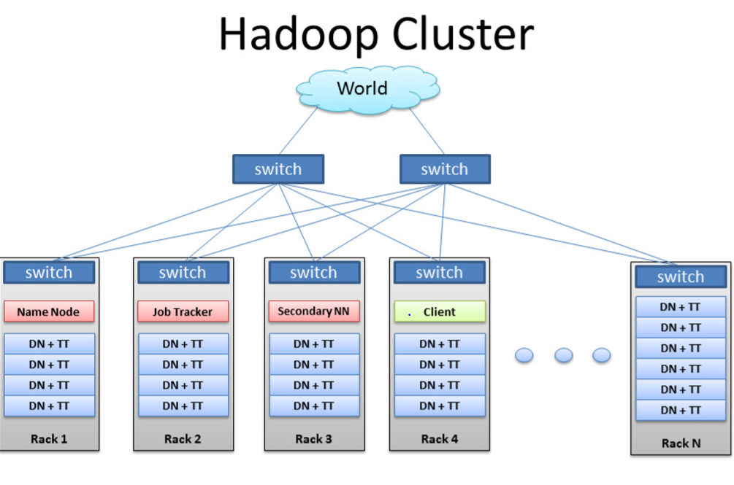
Architecture of Hadoop Cluster
There are rack servers populated in racks connected to a top of rack switch usually with 1 or 2 GigE boned links
The rack switch has uplinks connected to another tier of switches connecting all the other racks with uniform bandwidth, forming the cluster
Majority of servers are Slave Nodes with lots of local disk storage and moderate CPU and DRAM
Some machines will be Master Nodes which has more of CPU and DRAM and less local storage

Slide 9
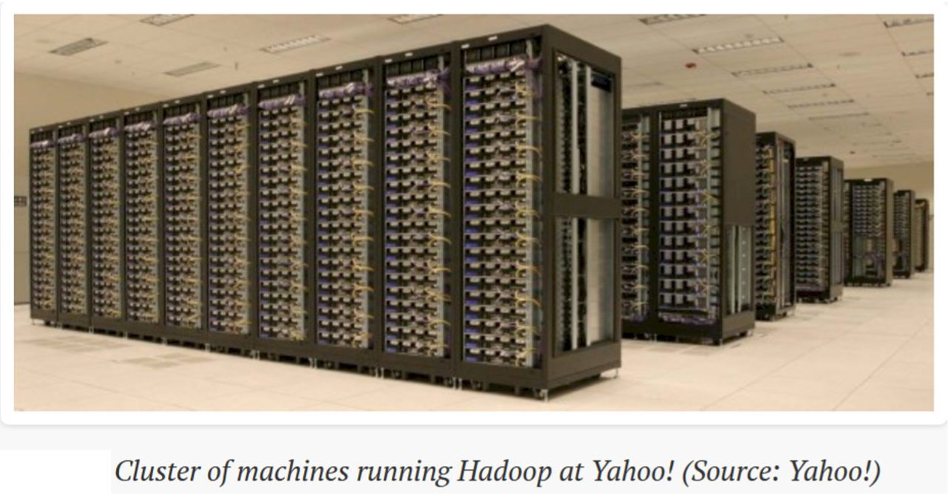
Hadoop Cluster at Yahoo!

Slide 10
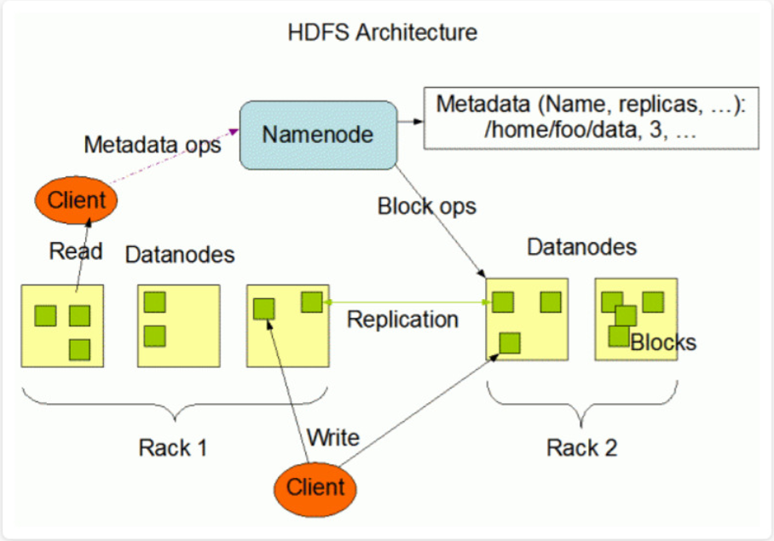
HDFS Architecture
The Hadoop Distributed File System (HDFS) is a distributed file system designed to run on commodity hardware
HDFS stores data reliably even in the case of hardware failure
HDFS provides high throughput access to application data by providing the data access in parallel and is suitable for applications having large data sets.
HDFS features include Rack awareness, high Availability, Data Blocks, Replication Management, HDFS data read and write operations

Slide 11
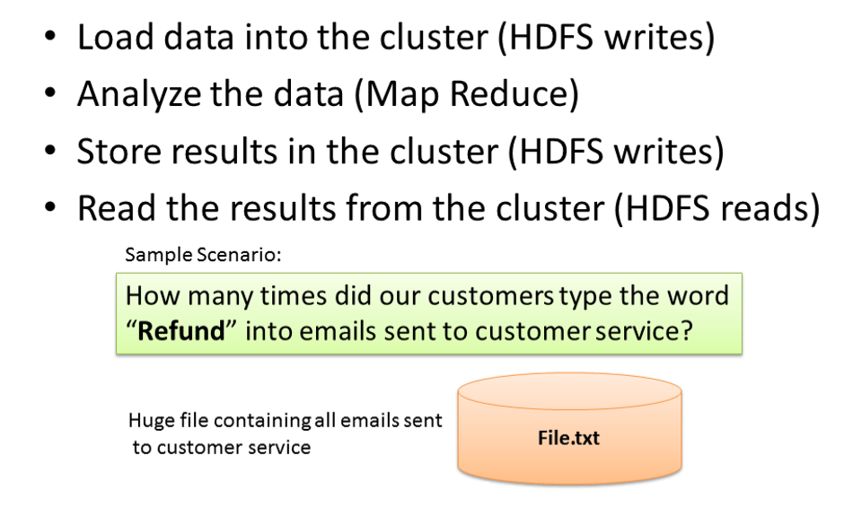
Typical Workflow

Slide 12
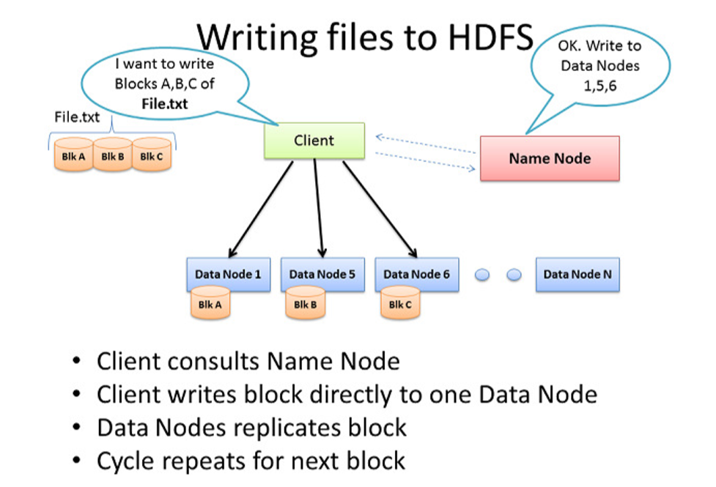
Writing Files to HDFS
Client will consult NameNode (usually TCP port 9000) to store data
Internally the files get divided into one or more blocks, and each block is stored on different DataNodes depending on the replication factor (standard:3) which is configured with dfs.replication parameter in hdfs-site.xml file
NameNode uses concept of ‘Rack Awareness’ to ensure every block of data is on multiple machines in the cluster to avoid data loss and improve network performance
Client then writes block directly to Data Node (usually TCP port 50010)
The NameNode only provides the map of where data is and where data should go in the cluster (file system metadata)

Slide 13
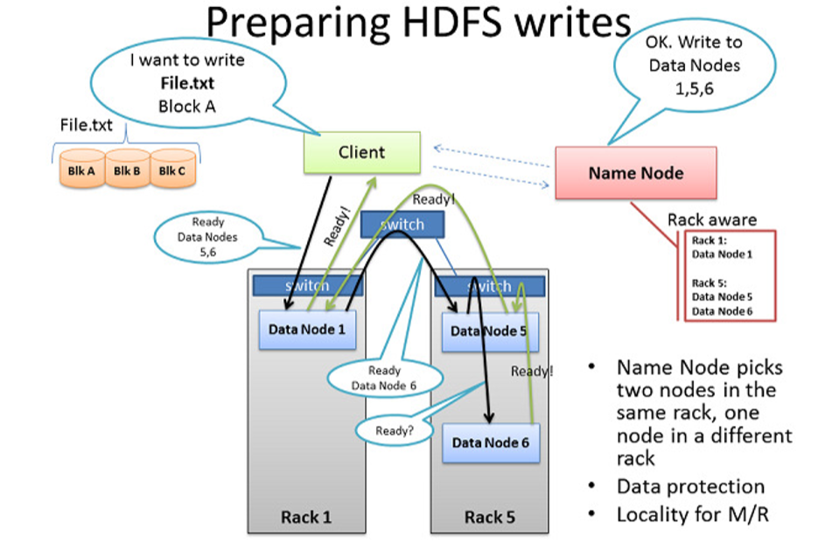
HDFS Data Write Pipeline
Before the client writes ‘Block A’ of File.txt to cluster, it wants to know if all DataNodes are ready to receive these blocks
It picks 1st DataNode in list for Block A, opens a TCP 50010 connection and says “Hey, get ready to receive a block and here’s a list of other 2 DataNodes
DN1 opens TCP connection to DN5 and DN5 in turn opens connection to DN6 to make them ready to receive blocks
The acknowledgments of readiness come back on same TCP pipeline, until the initial DN1 sends a “Ready” message back to Client
At this point, Client is ready to begin writing block data into the cluster

Slide 14
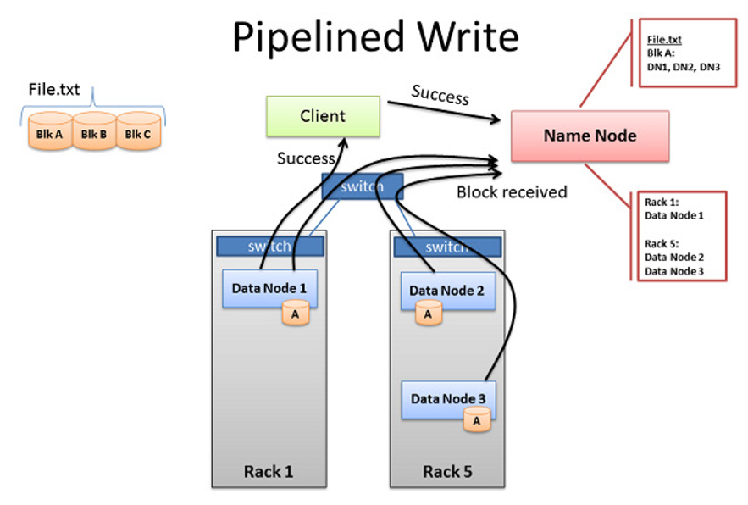
Multi-block replication pipeline and Success Message
When all 3 nodes have successfully received the block, they will send ‘Block Received’ report to NameNode
They will also send ‘Success’ message back up the pipeline and close all TCP sessions
Client receives ‘Success’ message and tells NameNode that block was successfully written
NameNode then updates its ‘metadata’ info with Node locations of each block of the file
Client is then ready to start the pipeline process again for next block of data

Slide 15
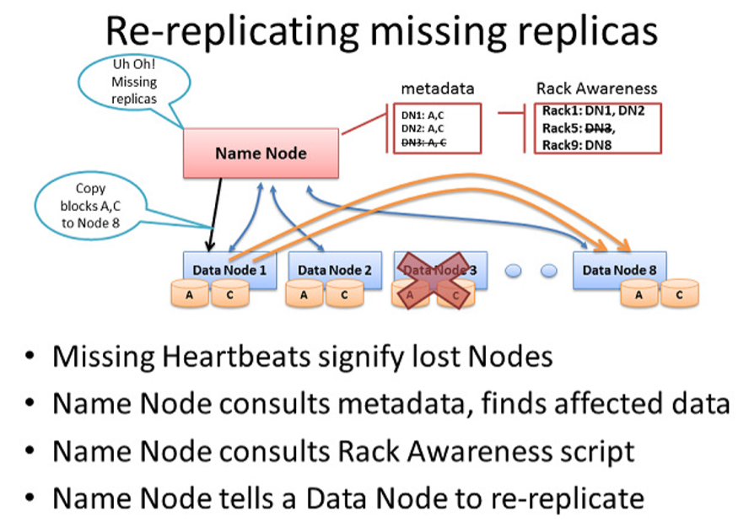
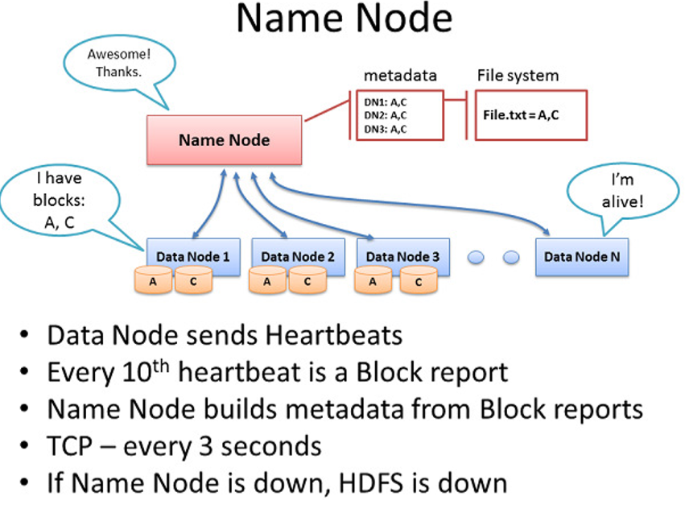
Data Re-Replication Mechanism

Slide 16
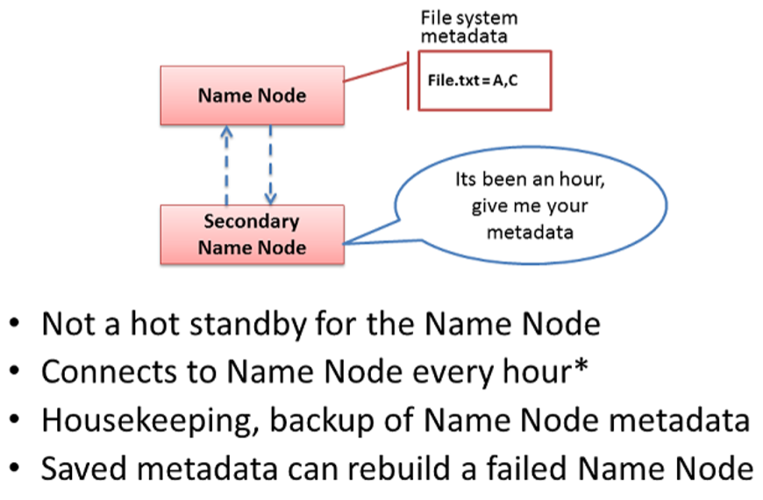
Secondary NameNode
Secondary NameNode connects to NameNode via TCP 9000 and grab’s a copy of Name Node’s in-memory metadata & files used to store metadata
It combines this set of files and delivers back to Name Node, while keeping a copy for itself
If Name Node dies, files retained by Secondary Name Node is used to recover the Name Node

Slide 17
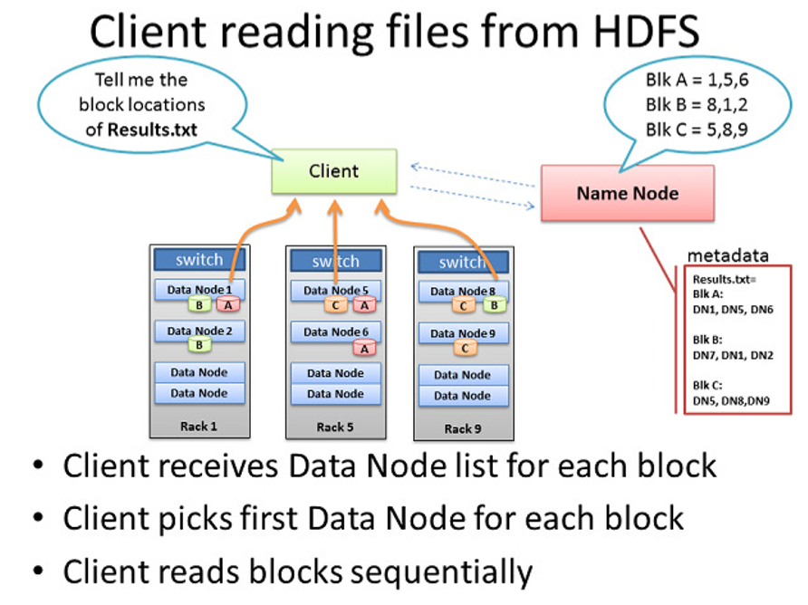
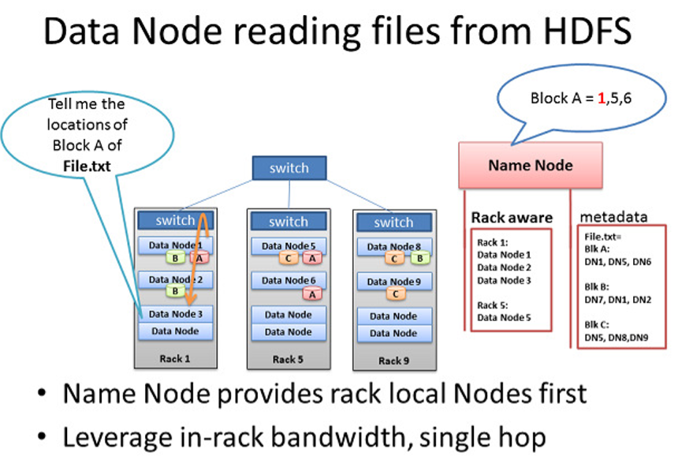
HDFS Reads

Slide 18
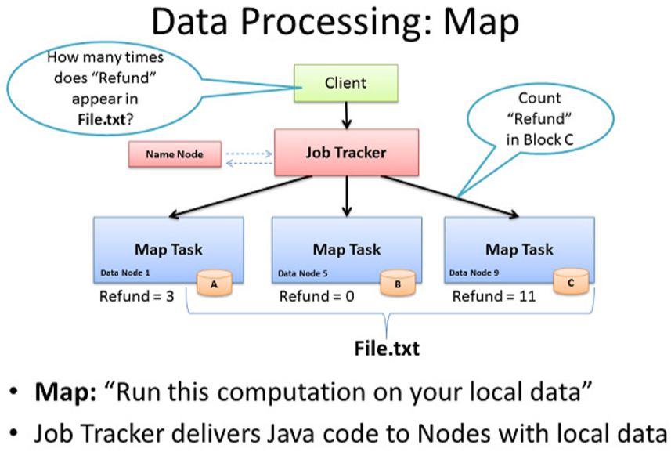
Data Processing: Map
Client submits MapReduce job to Job Tracker about getting word count of ‘Refund’ in file
Job Tracker consults NameNode to learn which DataNodes have blocks of file
It then provides Task Tracker running on those nodes with Java code to execute Map computation on their local data
As each Map task completes, each node stores result of its local computation in temporary local storage called ‘intermediate data’
It will then send this intermediate data over network to a node running a Reduce task for final computation

Slide 19
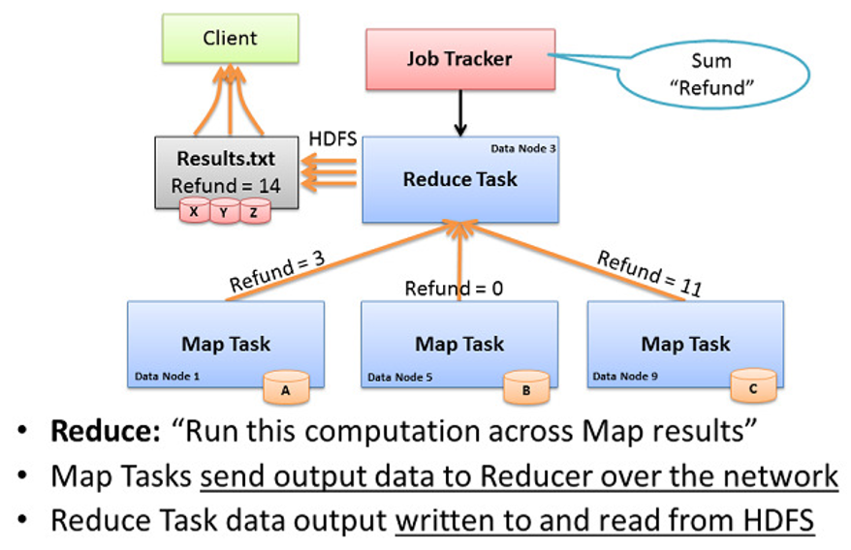
Data Processing: Reduce
Job Tracker starts Reduce task on any 1 node in cluster & instructs it to get intermediate data from all completed map tasks
Map task may respond to Reducer simultaneously, where a number of nodes are sending TCP data to 1 node all at once. This is called ‘Incast’ or ‘fan-in’
The Reducer than performs final computation by adding up sum total occurrences of word ‘Refund’ received from all Mapper tasks and writes final result to a file Results.txt

Slide 20
THANK YOU!!
Any Questions ???

